Slide 1
Information Theory and Coding Module 1
Presented By:
Dr. SALADI SARITHA
Associate Professor
School of Electronics Engineering
VIT-AP University

Slide 2
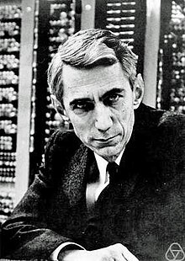
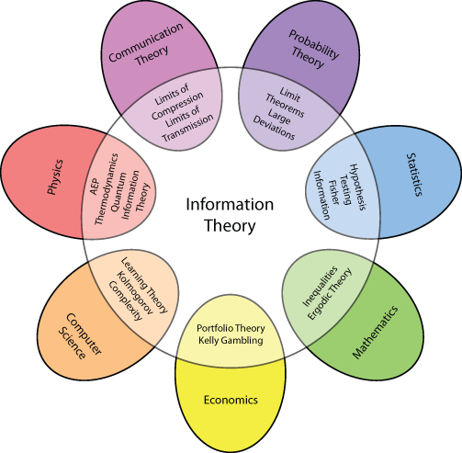
ITC: Applications
Claude Shannon
The capacity can be computed simply from the noise characteristics of the channel.
Shannon further argued that random processes such as music and speech have an irreducible complexity below which the signal cannot be compressed.

Slide 3

What is Information
Weather Forecast:
It would be hot and sunny.
There would be scattered rain.
There would be cyclone and thunderstorm.
Note: Amount of information is related to probability of occurrence.

Slide 4
What is Information
Let us consider the following statements:
Tomorrow, the sun will rise from the East.
The phone will ring in the next one hour.
It will snow in Delhi this winter.
From above statements, the amount of information is nothing to do with the length of the sentences.
Also, it is interesting to note that the amount of information carrying is inversely proportional to the probability of occurrences of the events.
Shannon gave the mathematical definition to quantify the amount of information through his published work titled “A Mathematical Theory of Communication”.

Slide 5
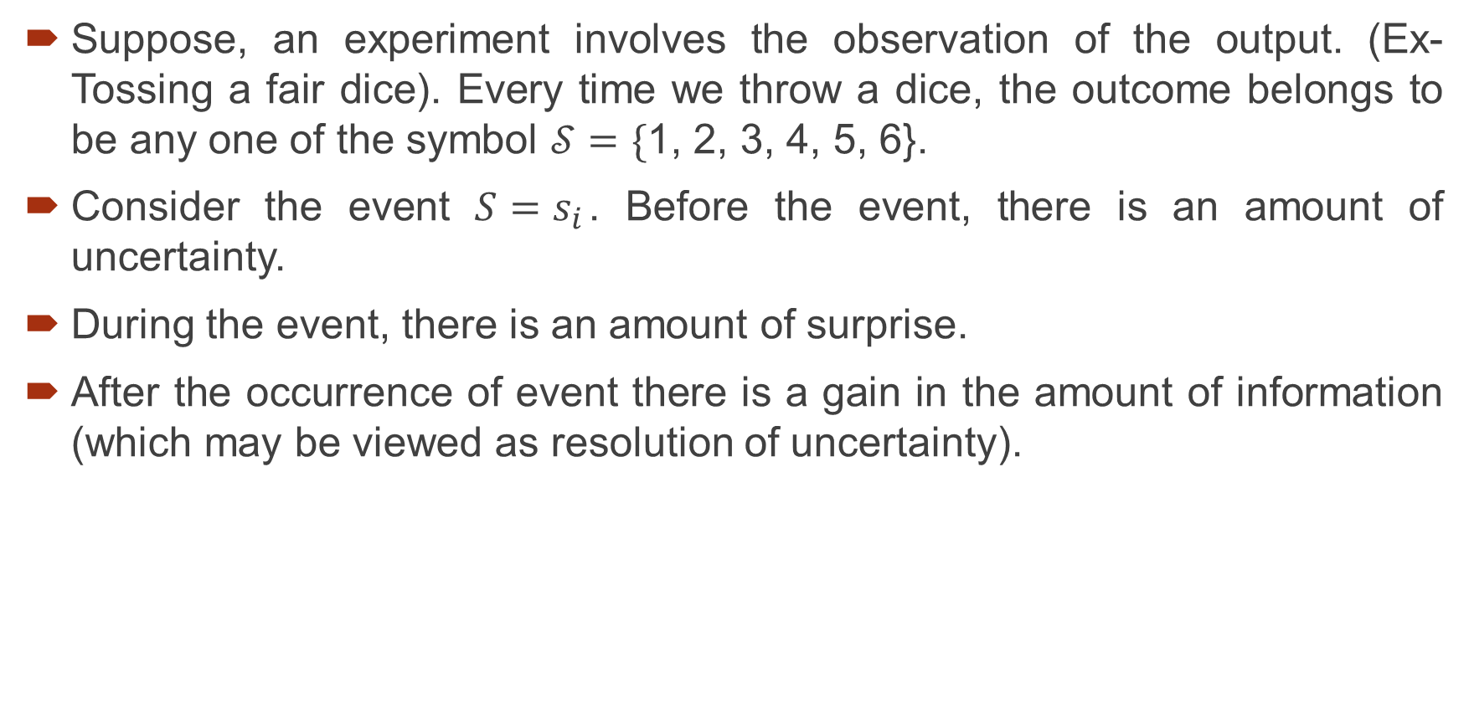
Uncertainty and Information
Suppose, an experiment involves the observation of the output. (Ex- Tossing a fair dice). Every time we throw a dice, the outcome belongs to be any one of the symbol $𝒮=\{$1, 2, 3, 4, 5, 6}.
Consider the event $S=s_{i}$. Before the event, there is an amount of uncertainty.
During the event, there is an amount of surprise.
After the occurrence of event there is a gain in the amount of information (which may be viewed as resolution of uncertainty).

Slide 6
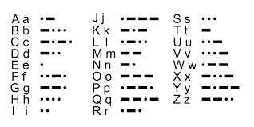
Information Sources
In communication system, it can be a device sending message, it can be continuous or discrete.
Continuous sources can be converted to discrete sources by sampling and quantization.
Therefore, discrete information source is a source which has only a finite set of symbols as possible output.
Ex: Mores Code:

Slide 7
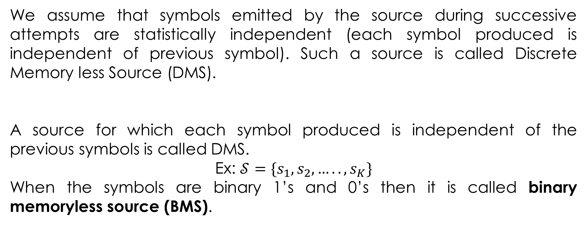
Memoryless Sources
We assume that symbols emitted by the source during successive attempts are statistically independent (each symbol produced is independent of previous symbol). Such a source is called Discrete Memory less Source (DMS).
A source for which each symbol produced is independent of the previous symbols is called DMS.
Ex: $𝒮=\{s_{1}, s_{2},….., s_{K}\}$
When the symbols are binary 1’s and 0’s then it is called binary memoryless source (BMS).

Slide 8
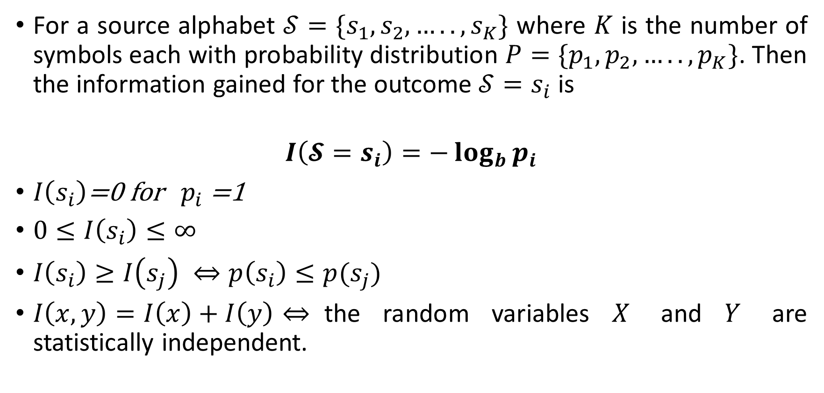
Measure of Information
For a source alphabet $𝒮=\{s_{1}, s_{2},….., s_{K}\}$ where $K$ is the number of symbols each with probability distribution $P=\{p_{1}, p_{2},….., p_{K}\}$. Then the information gained for the outcome $𝒮=s_{i}$ is
$$I\left({𝓢=s}_{i}\right)=−\log_{b}{p_{i}}$$
$I\left(s_{i}\right)$=0 for $p_{i}$ =1
$0≤I\left(s_{i}\right)≤∞$
$I\left(s_{i}\right)≥I\left(s_{j}\right) ⇔p\left(s_{i}\right)≤p(s_{j})$
$I\left(x,y\right)=I\left(x\right)+I\left(y\right)⇔$the random variables $X$ and $Y$ are statistically independent.

Slide 9
Measure of Information
Unit:
bits if b=2,
Hartley or decit if b =10,
nat (natural unit) if b = e.
$$I\left({𝒮=s}_{i}\right)=−\log_{b}{p_{i}}$$

Slide 10
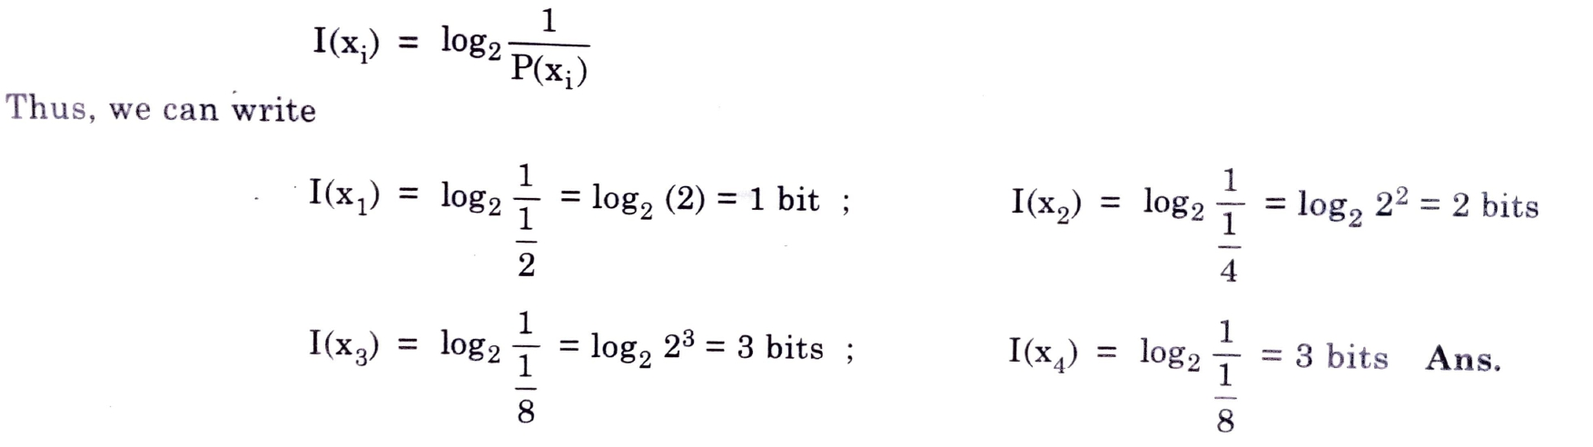
Example on Information content
Q: A source produces one of four possible symbols, having probability P(x₁)= ½, P(x₂)= ¼, P(x₃)= P(x₄)=1/8. Obtain the information content of each of these symbol.
Ans:

Slide 11
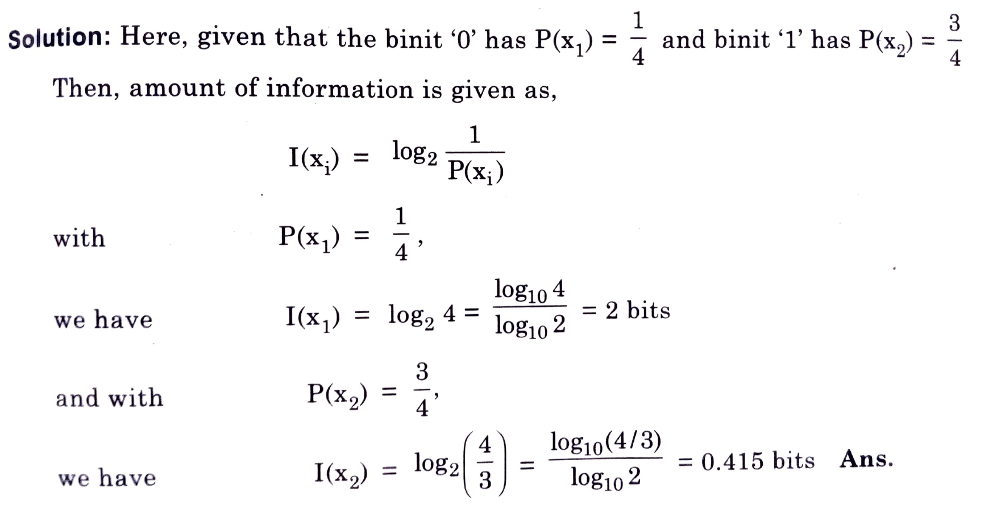
Example on Information content
Q: In a binary channel, of ‘0’ occurs with probability ¼ and ‘1’ occurs with probability of ¾. Then, calculate the amount of information carried by each binit.

Slide 12
Example on Information content
Q: If there are M equally likely and independent symbols, then prove that amount of information carried by each symbol will be:
I (si)=N bits.
Where, M = 2^{N} and N is an integer.
(Prove This)

Slide 13
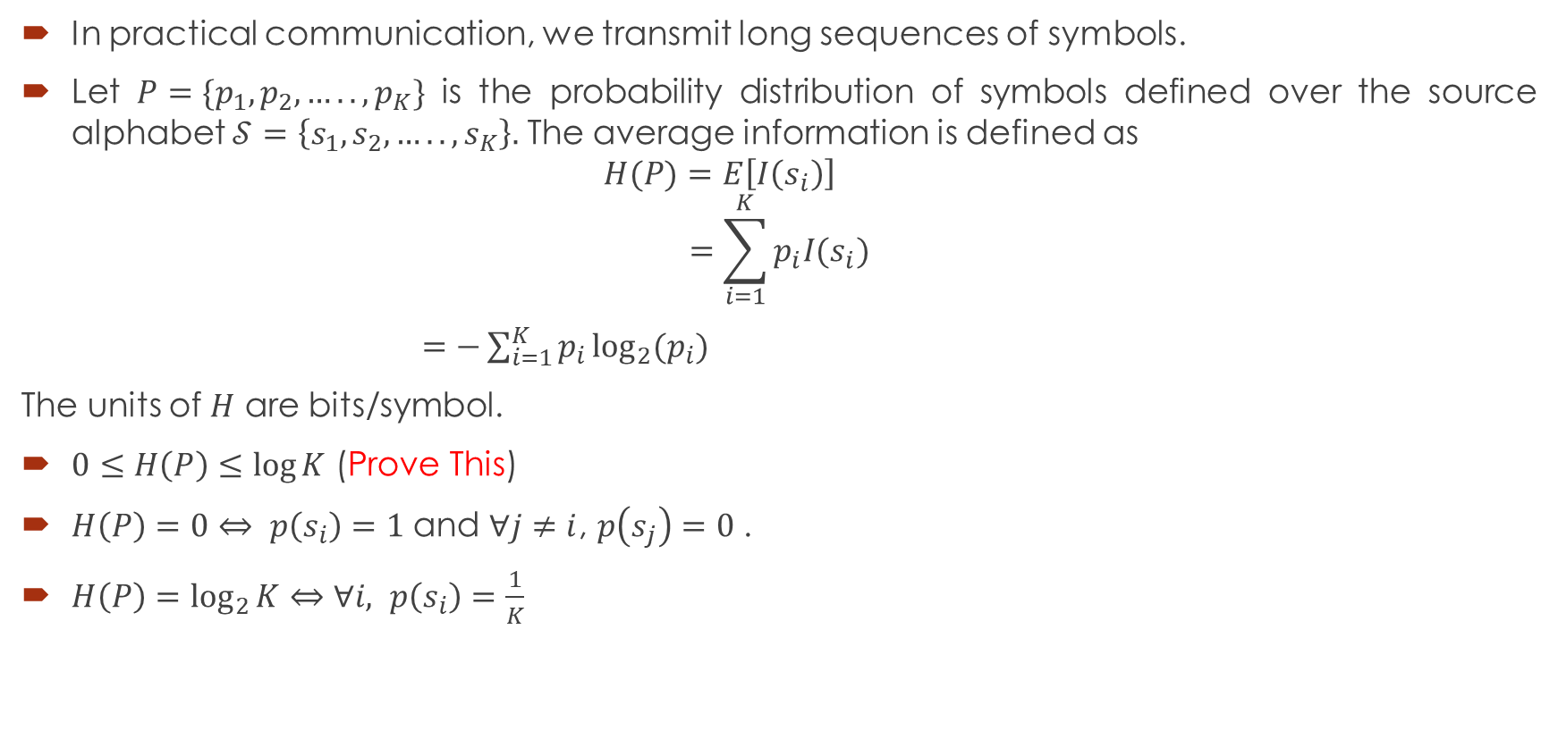
Entropy (Average Information per symbol)
In practical communication, we transmit long sequences of symbols.
Let $P=\{p_{1}, p_{2},….., p_{K}\}$ is the probability distribution of symbols defined over the source alphabet $𝒮=\left\{s_{1}, s_{2},….., s_{K}\right\}.$ The average information is defined as
$$H(P)=E\left[I\left(s_{i}\right)\right]$$
$$=\sum_{i=1}^{K}{p_{i}I(s_{i})}$$
$=−\sum_{i=1}^{K}{p_{i}}\log_{2}⁡(p_{i})$
The units of $H$ are bits/symbol.
$0≤H\left(P\right)≤\log{K}$ (Prove This)
$H\left(P\right)=0⇔ p\left(s_{i}\right)=1$ and $∀j≠i$, $p\left(s_{j}\right)=0$ .
$H\left(P\right)=\log_{2}{K}⇔$ $∀i, p\left(s_{i}\right)=\frac{1}{K}$
Note: $⇔$ indicates if and only if

Slide 14

Entropy of BMS
Let $𝒮=\{0,1\}$ be the BMS with probability distribution function as $P=\{p,1−p\}$. Then the entropy of BMS is:
$$H\left(P\right)=−p\log{p}−\left(1−p\right)\log\left(1−p\right)$$
$H\left(P\right)$vs$p$
(Make a MATLAB program to prove this curve)

Slide 15

Information Rate
If the time rate at which $𝒮$ emits symbols is $r$ (symbols/sec), then the information rate $R$ of the source is given by
$R=rH(P)$ bits/second
H(P) is entropy or average information.
r is rate at symbols are generated.

Slide 16
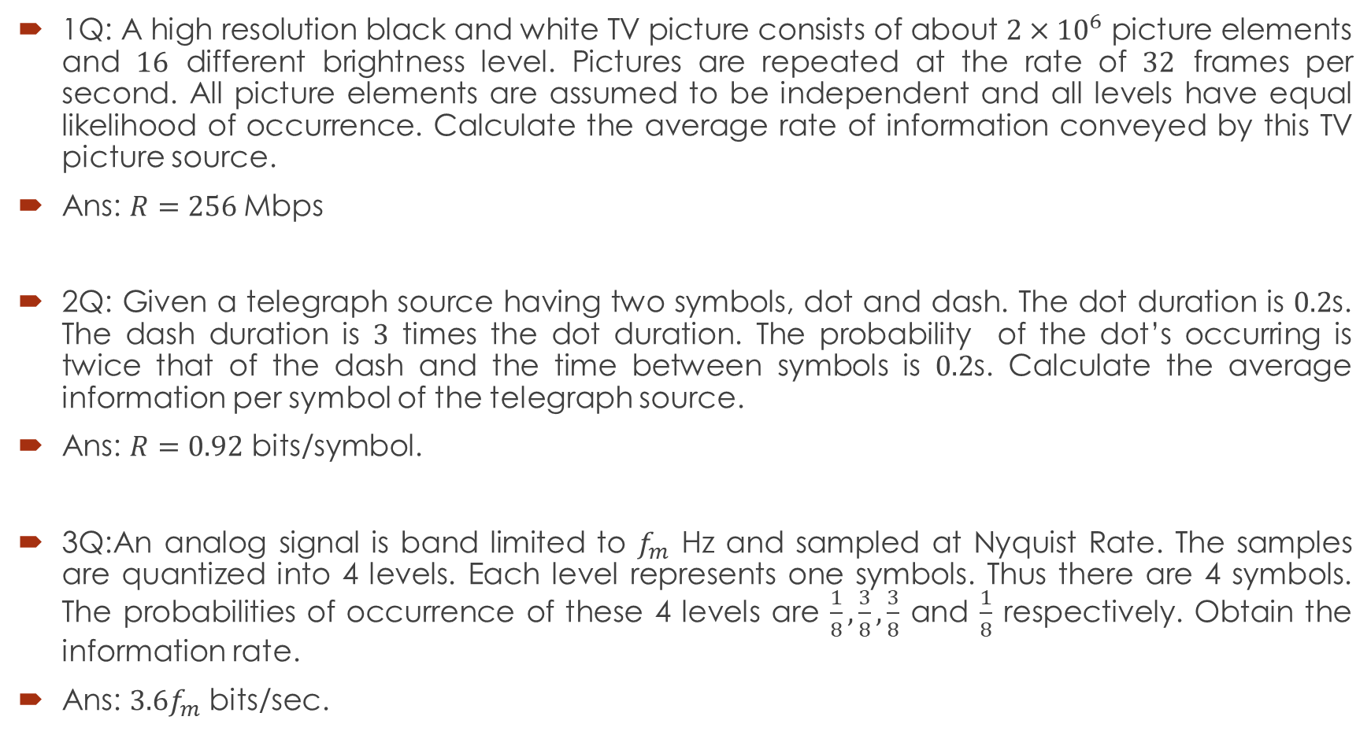
Examples
1Q: A high resolution black and white TV picture consists of about $2×{10}^{6}$ picture elements and $16$ different brightness level. Pictures are repeated at the rate of $32$ frames per second. All picture elements are assumed to be independent and all levels have equal likelihood of occurrence. Calculate the average rate of information conveyed by this TV picture source.
Ans: $R=256$Mbps
2Q: Given a telegraph source having two symbols, dot and dash. The dot duration is $0.2$s. The dash duration is $3$ times the dot duration. The probability of the dot’s occurring is twice that of the dash and the time between symbols is $0.2$s. Calculate the average information per symbol of the telegraph source.
Ans: $R=0.92$ bits/symbol.
3Q:An analog signal is band limited to $f_{m}$ Hz and sampled at Nyquist Rate. The samples are quantized into 4 levels. Each level represents one symbols. Thus there are 4 symbols. The probabilities of occurrence of these 4 levels are $\frac{1}{8},\frac{3}{8},\frac{3}{8}$ and $\frac{1}{8}$ respectively. Obtain the information rate.
Ans: $3.6f_{m}$ bits/sec.

Slide 17
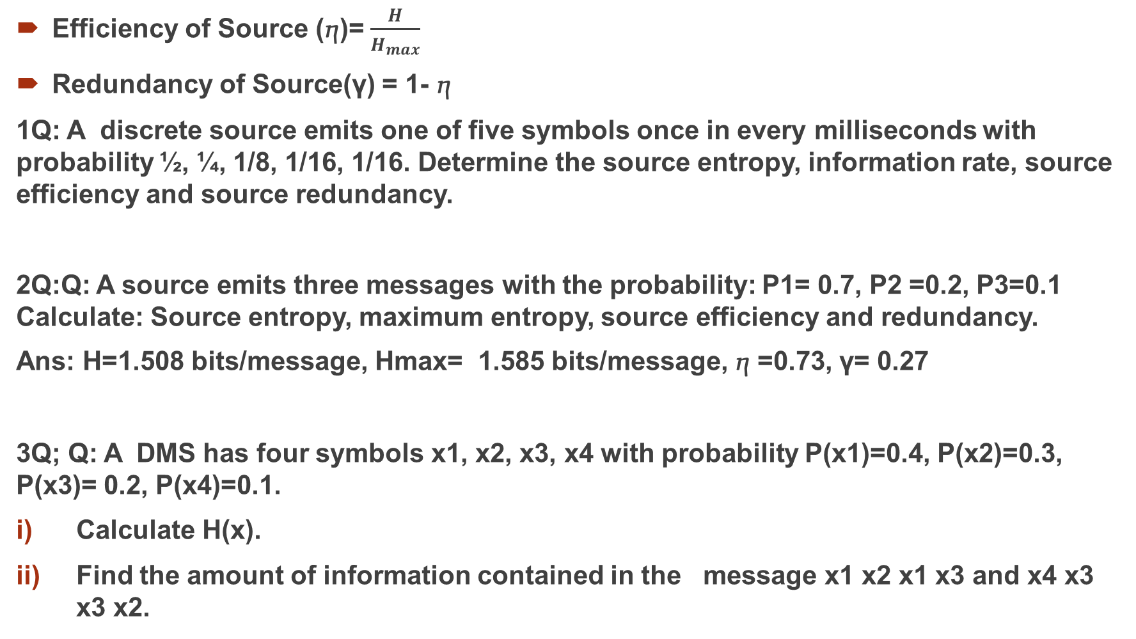
Efficiency of Source (ⴄ)= $\frac{H}{H_{max}}$
Redundancy of Source(γ) = 1- ⴄ
1Q: A discrete source emits one of five symbols once in every milliseconds with probability ½, ¼, 1/8, 1/16, 1/16. Determine the source entropy, information rate, source efficiency and source redundancy.
2Q:Q: A source emits three messages with the probability: P1= 0.7, P2 =0.2, P3=0.1 Calculate: Source entropy, maximum entropy, source efficiency and redundancy.
Ans: H=1.508 bits/message, Hmax= 1.585 bits/message, ⴄ =0.73, γ= 0.27
3Q; Q: A DMS has four symbols x1, x2, x3, x4 with probability P(x1)=0.4, P(x2)=0.3, P(x3)= 0.2, P(x4)=0.1.
Calculate H(x).
Find the amount of information contained in the message x1 x2 x1 x3 and x4 x3 x3 x2.

